Slide 1
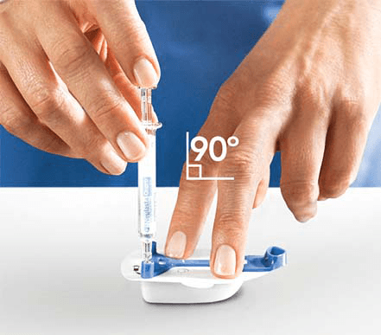
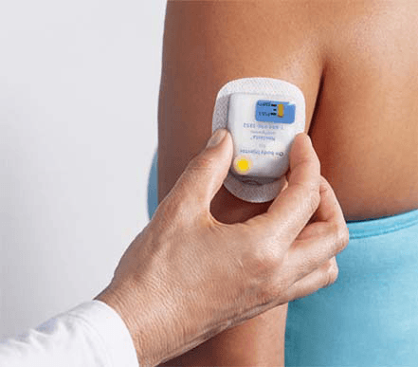
Neulasta Onpro How does the device work?
Nurse injects the drug Neulasta (pegfilgrastim) into the on-body injector
The injector is taped to back of the patient’s arm or to the abdomen

Slide 2
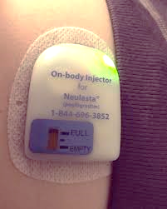
Neulasta Onpro How does the device work?
3 minutes after Neulasta is injected into the device, a cannula pops out to implant into the skin
The cannula remains implanted into the skin and does not retract back into the device
A green light on the device starts to blink and indicates that it is working properly
The gauge on the device should appear FULL

Slide 3
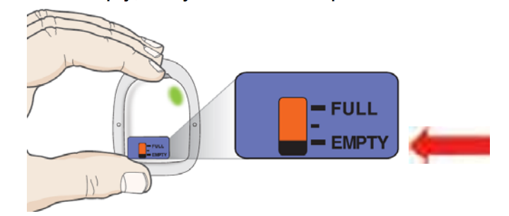
Neulasta Onpro How does the device work?
About 27 hours after the device was placed, the injector will beep to let the patient know the device will start the injection
It takes 45 minutes to inject the dose
The green light blinks faster while injecting
The injection is complete when the green light stops blinking or it turns off
The gauge will read EMPTY

Slide 4
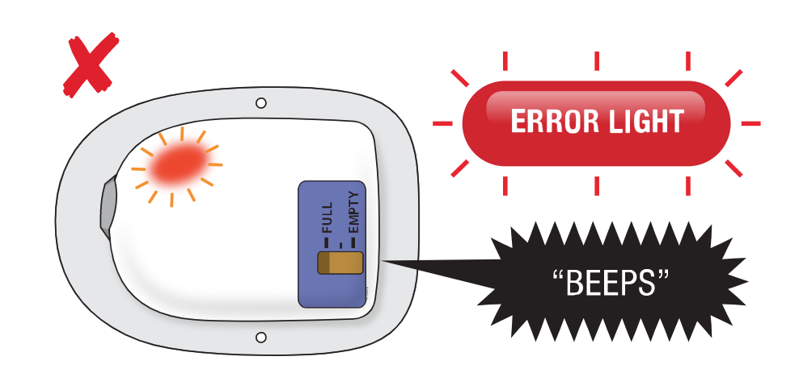
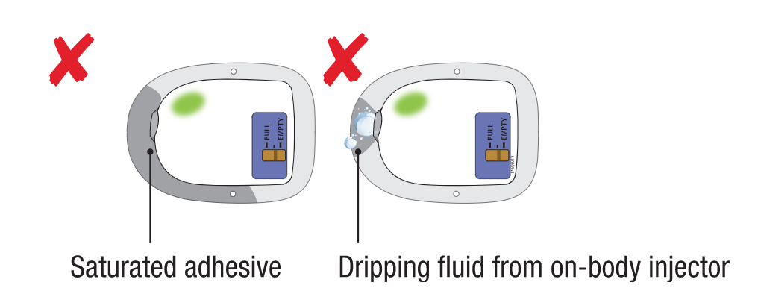
What can go wrong with the device?
1. The light can turn red. A red light means the device is not able to function properly.
3. If the cannula accidentally pulls out of the skin, the device will leak as the drug is being administered
2. The device may fall off

